Slide 1
BASIC JAPANESE LANGUAGE 1
GLT1031 (WEEK 4)

Slide 2
PREVIOUS CONTENT
Week 1 : Introduction to course & Japanese, Greetings | Course Information, Proforma & Spectrum Pronunciation, Sentence structure & Writing system
Week 2: Japanese Writing System | Hiragana Katakana
Week 3 : asynchronous | Self-study on next lesson Revision on previous lesson

Slide 3


03
じこ しょうかい
Self-introduction

Slide 4
CONTENTS OF THIS TOPIC
About topic : | To give a simple self introduction
Grammar : | Tell your name Talk about occupation Talk about nationality Talk about ability to speak what language Particle も

Slide 5
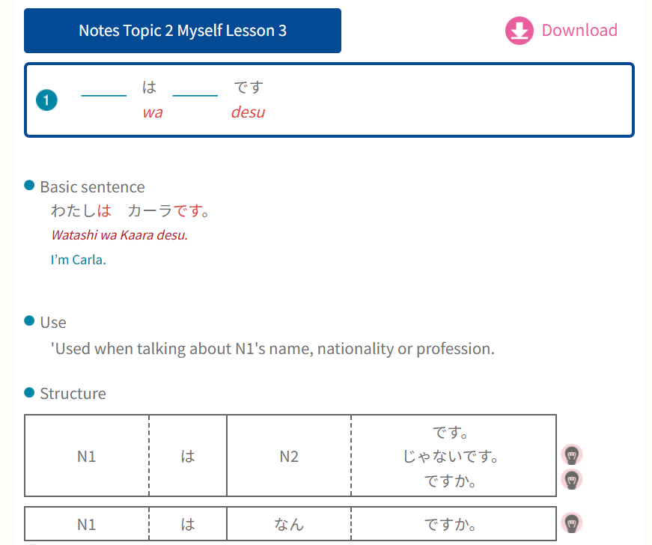
GRAMMAR PART
① Name, occupation &
nationality

Slide 6
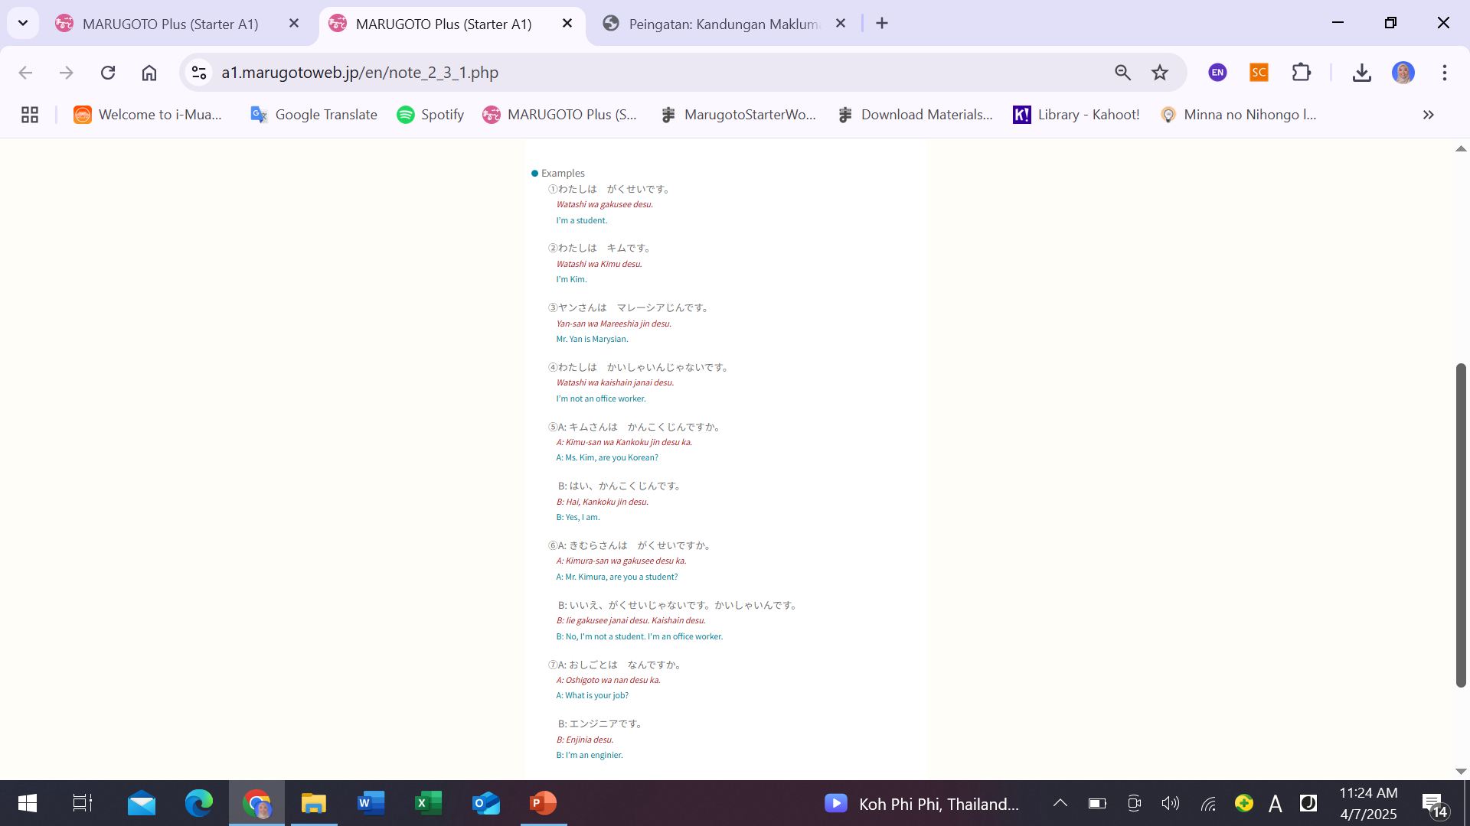

Slide 7
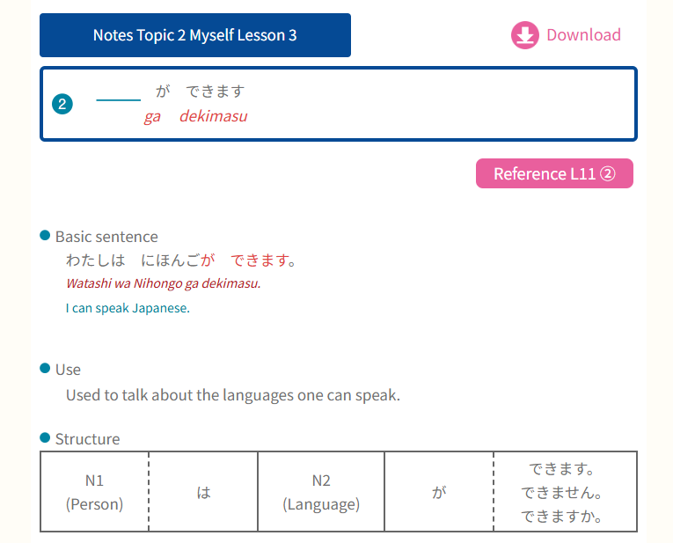
GRAMMAR PART
② Talk about ability to speak
what languages

Slide 8
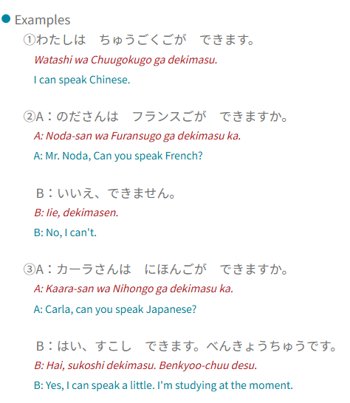

Slide 9
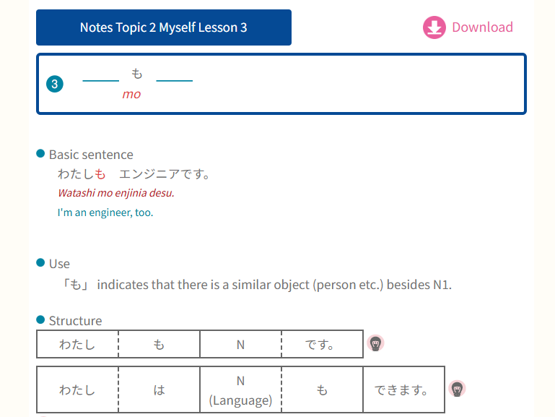
GRAMMAR PART
③ Particle も
も = too, also, as well
Used to say something that is
the same as what was said before
(repition of the topic or content)

Slide 10
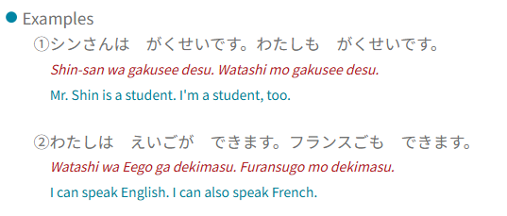

Slide 11
じこ しょうかい
はじめまして – hajimemashite nice to meet you
わたし は (name) です – watashi wa (name) desu
わたし は (occupation) です – watashi wa (occupation) desu
わたし は (nationality) です – watashi wa (nationality) desu
わたし は (language) が できます – watashi wa (language) ga dekimasu
わたし は (another language) も できます。- watashi wa (language) mo dekimasu
（どうぞ）よろしく おねがいします – (doozo) yoroshiku onegaishimasu – please treat me well

Slide 12
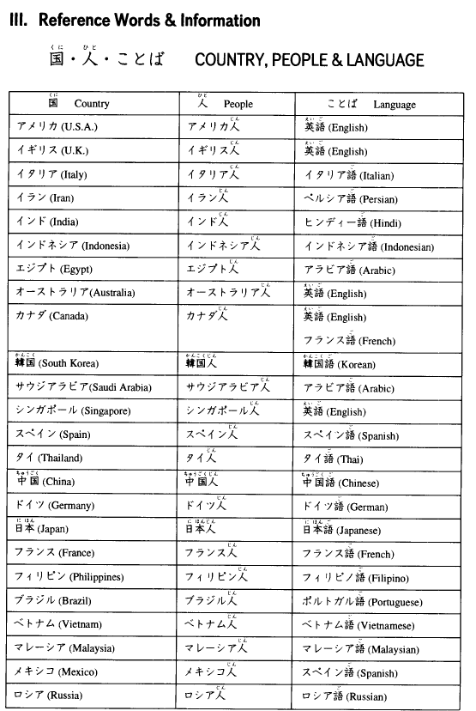
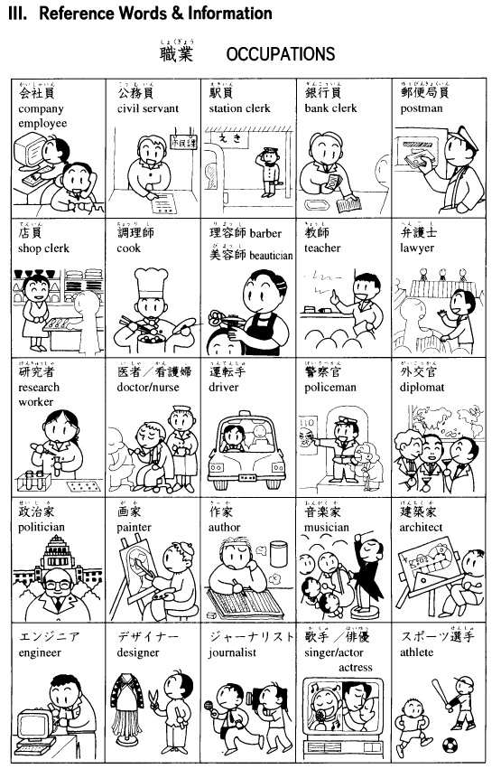
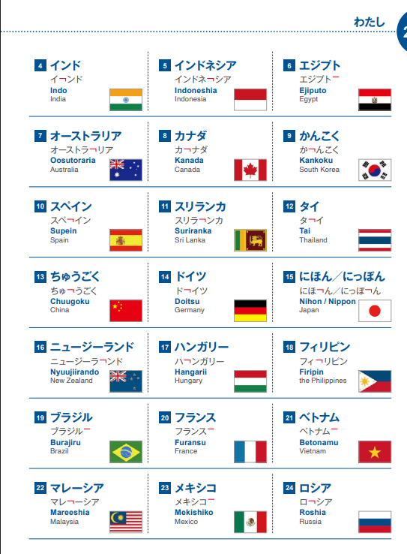

REFERENCE FOR VOCABS

Slide 13
6: zjnwix
6M: 25hqlz

Slide 14


